Slide 1
Department Programme 2025-26
1-Reading Day-June 20,2025
2-Field Visit to Anchuthengu Fort and Attingal Palace- August 14,2025
3-Orientation cum Motivation class-November 03, 2025

Slide 2

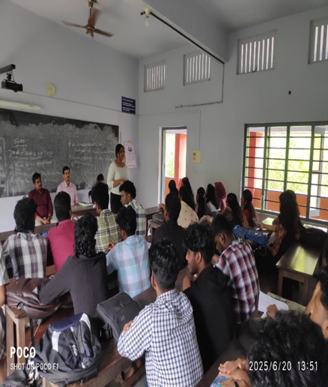
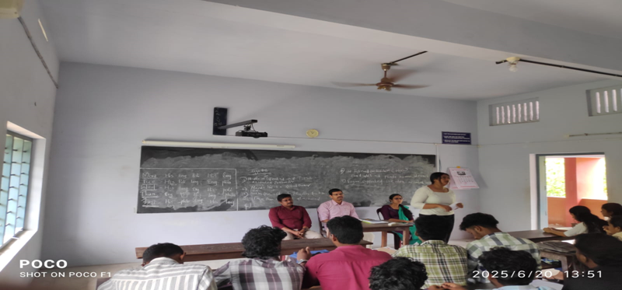

Slide 3
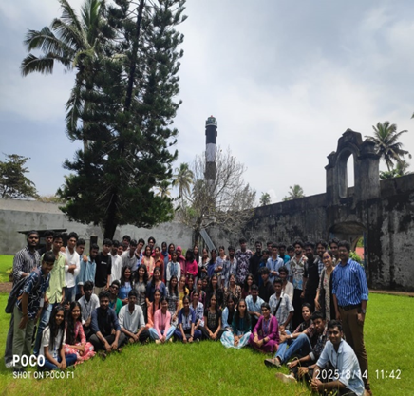
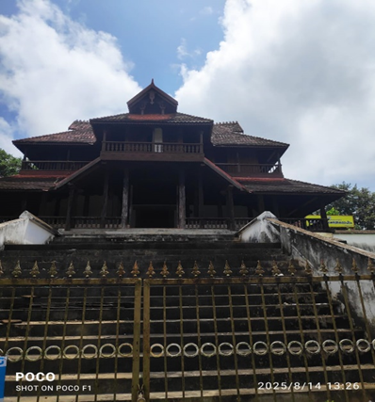

Slide 4

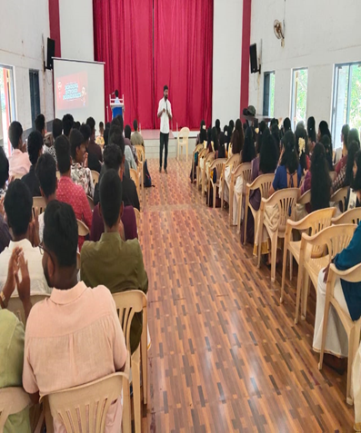
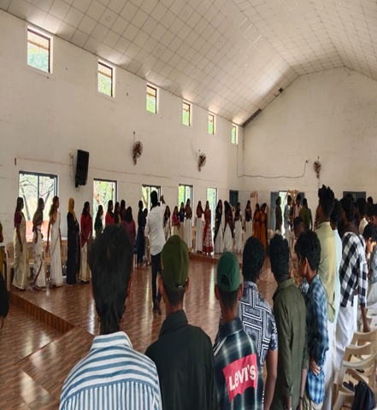

Slide 5
Department of Philosophy 2025-26
Yoga Practical Training- February 17, 2026
Professional Ethics-March 17, 2026

Slide 6
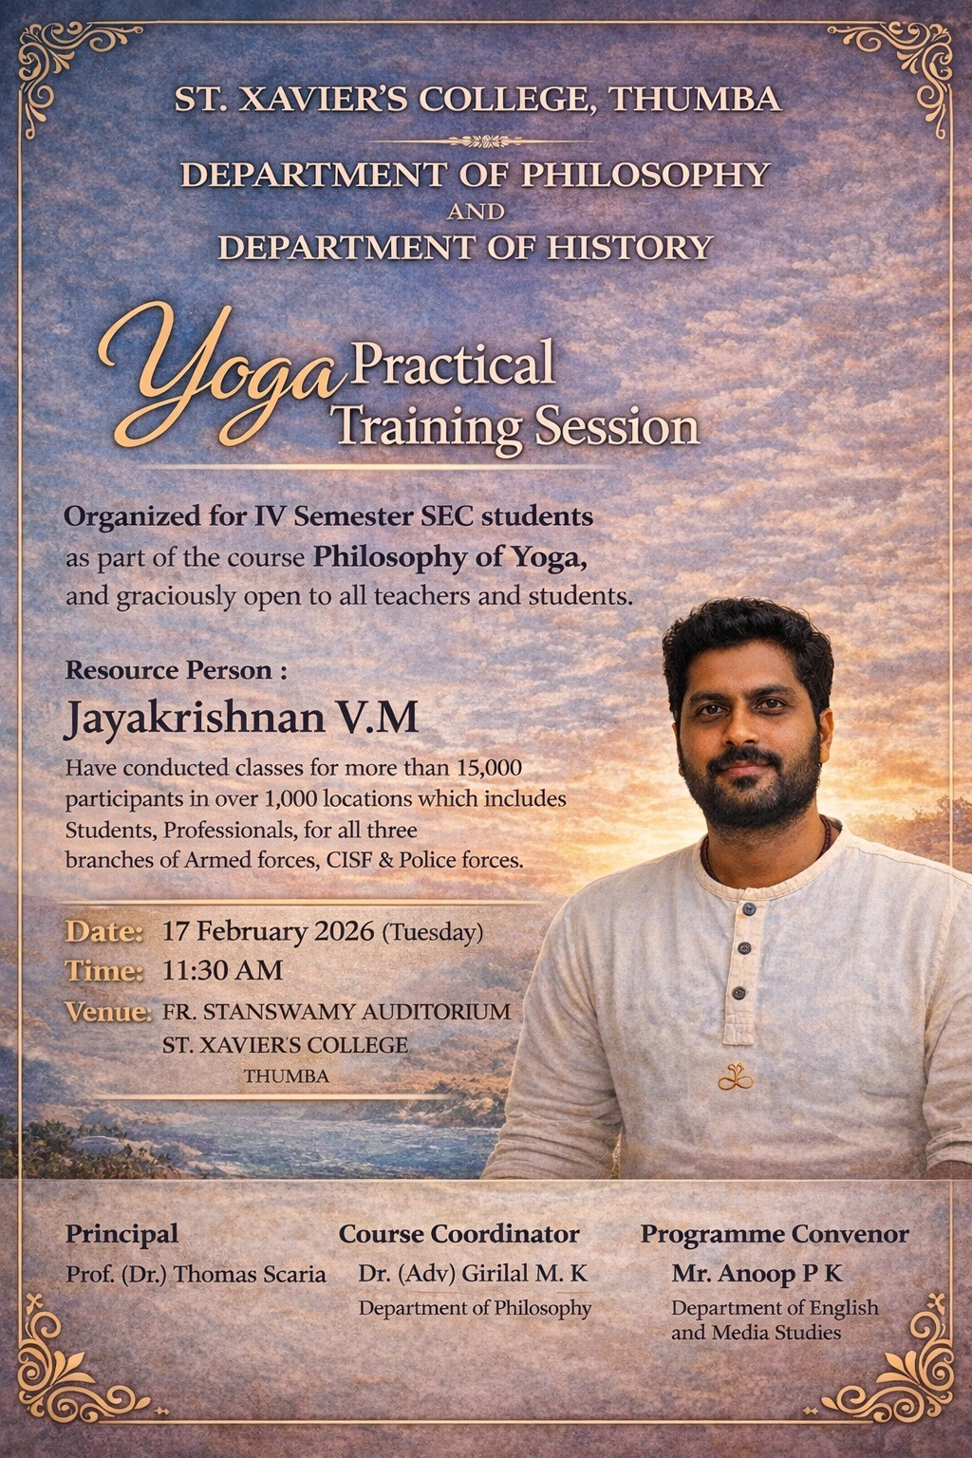
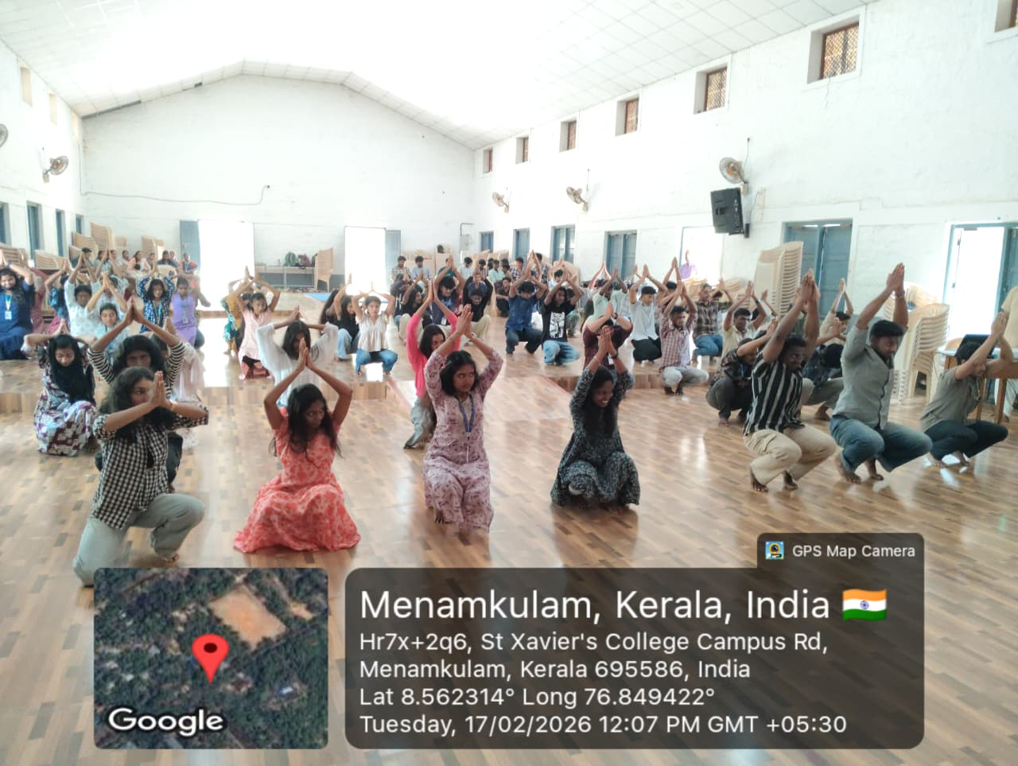
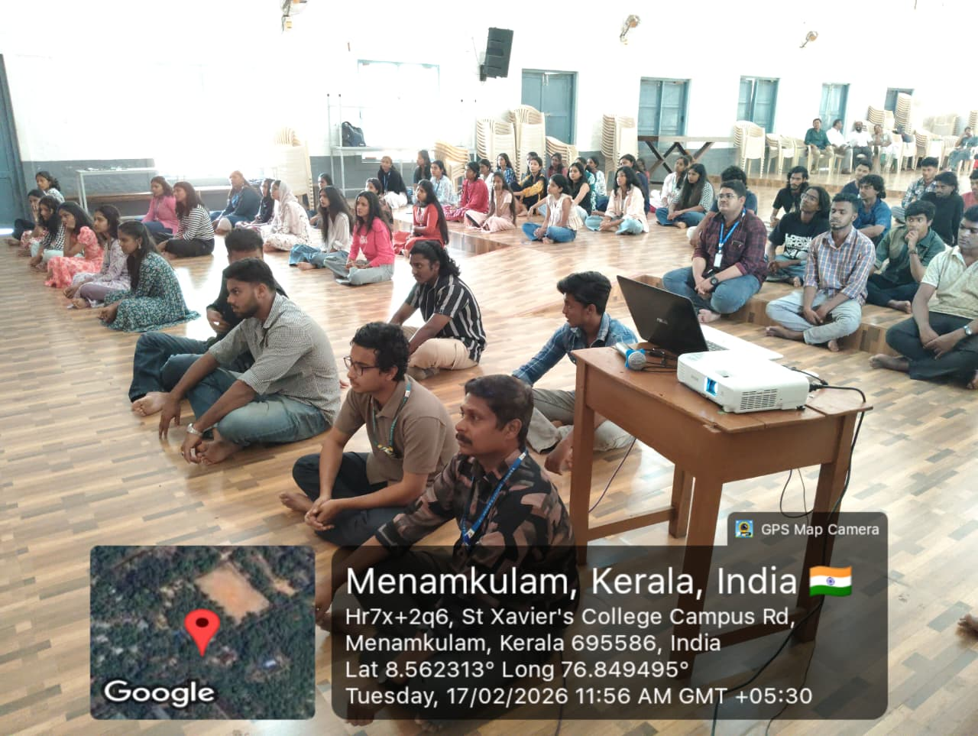

Slide 7
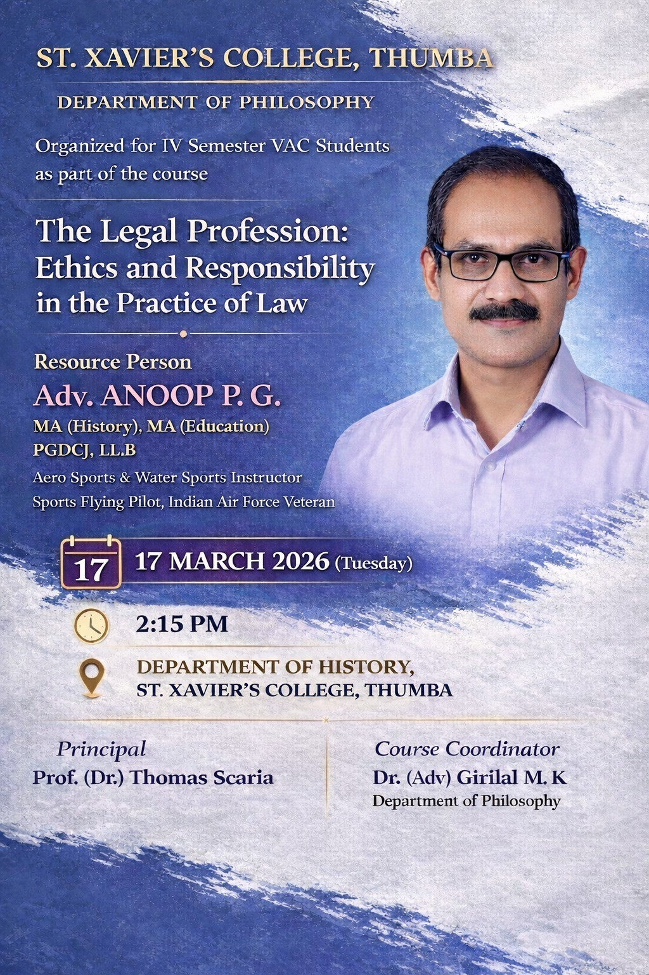
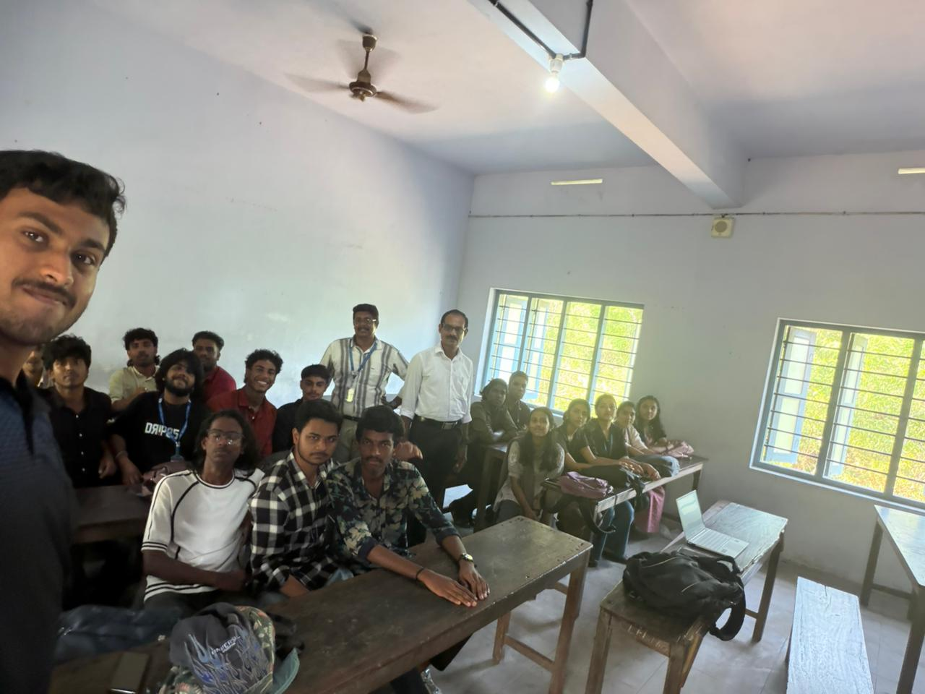
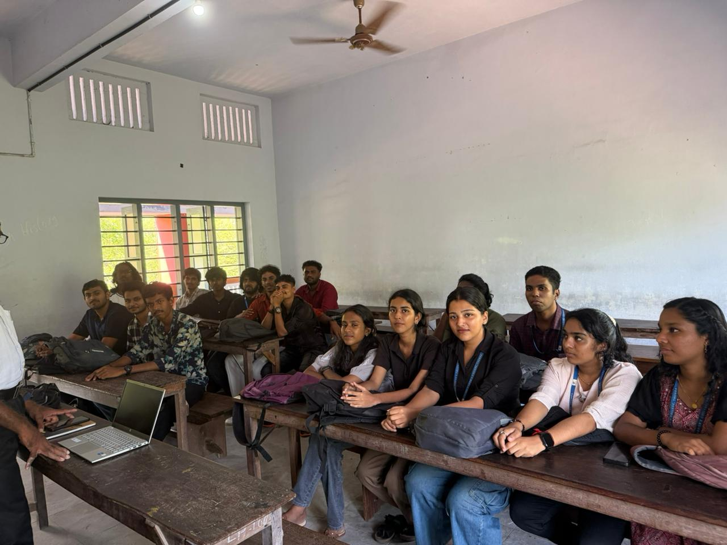

Slide 8
Department of Political Science 2025-26
Observance of Constitution Day-November 26, 2025
Two-day National Seminar on Role of Judiciary and Media in Protecting Democracy and Constitution-January 28-29, 2026

Slide 9
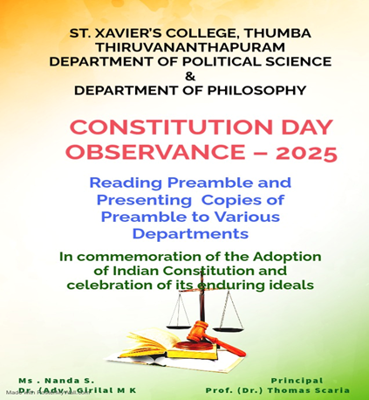
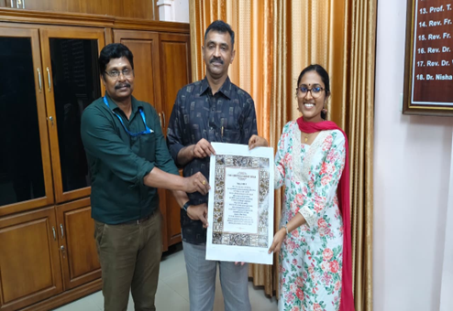
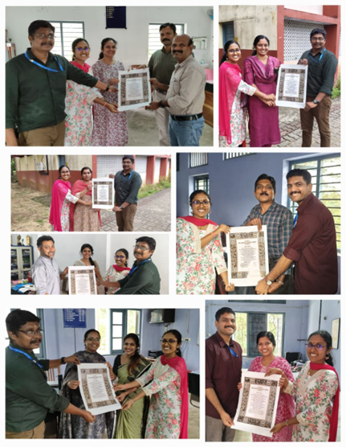
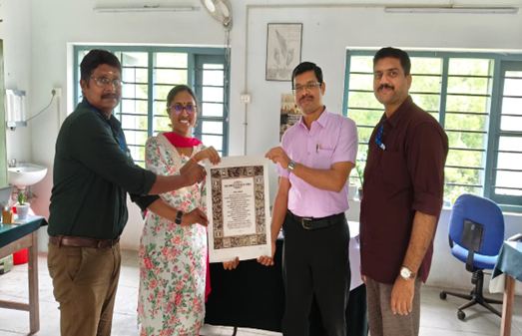
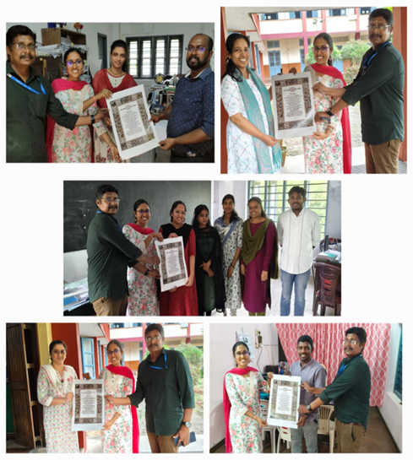

Slide 10
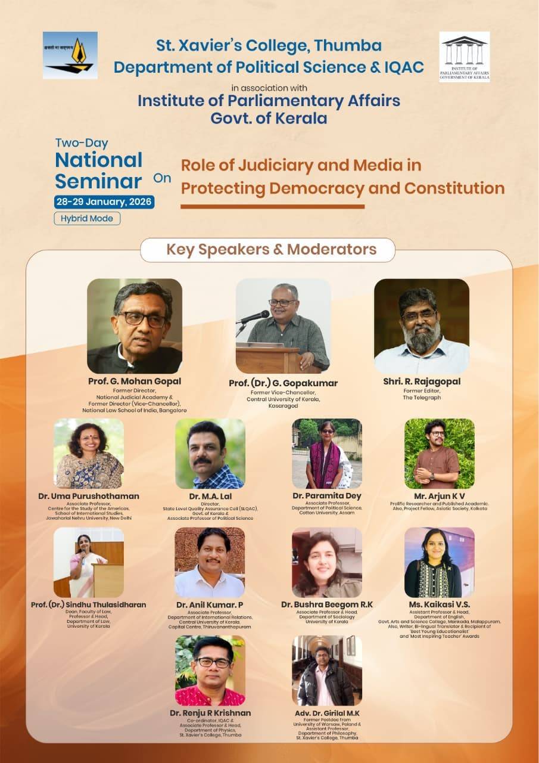
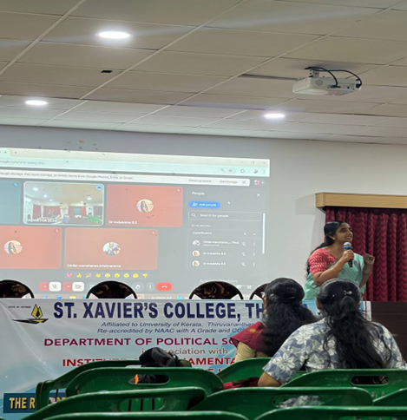
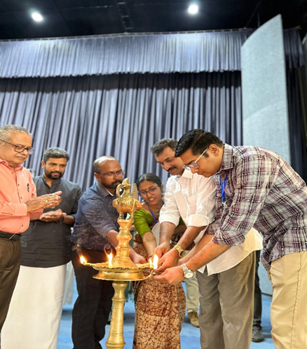
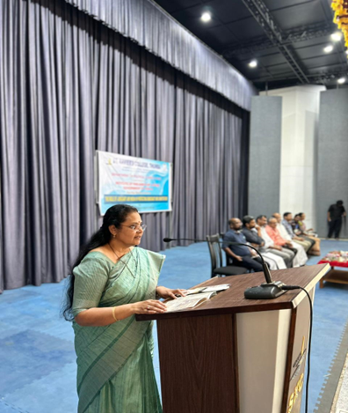
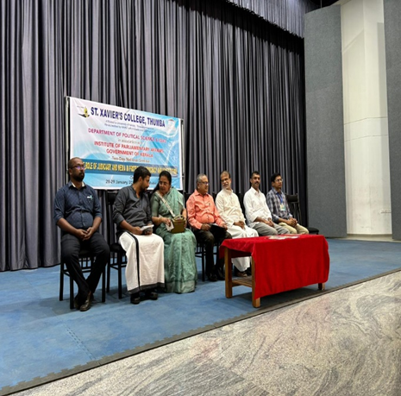

Slide 11
Result Analysis
YEAR/ SEM | I SEM | II SEM | III SEM | IV SEM | V SEM | VI SEM
First Sem (FYUGP-2025) | 12/40 30%
Third Sem (FYUGP-2024) | 13/33 39.39% | 13/33 39.39% | 8/29 27.58%
Fifth Sem (2023 Admis) |  | 8/42 19.04% | 20/42 47.6% | 21/41 51.2% | 23/40 57.5% | 24/30 80% Degree passed 12/30=40%

