Slide 1
HUMAN RIGHTS CLUB –REPORT OF ACTIVITIES DONE IN THE ACADEMIC YEAR 2025-26
Club Co-ordinators
Dr. Ramesh P., Head,
Department of History
Ms. Nanda S. – Faculty Member of Political Science

Slide 2
ACTIVITIES PROPOSED FOR THE ACADEMIC YEAR 2025-26
Human Rights Day Observance – December 10.
Invited Lectures/Seminars, Group Discussions/Debates, Competitions, Film Screening
Sensitisation of the theme and essence of Human Rights through Skit/Mime/Dance.
Outreach/Extension Programmes/Field Visits/Case Studies/Advocacy Campaigns.

Slide 3
ACTIVITIES DONE
1) Seminars, Group Discussions, Debates, Brainstorming and Think-Pair-Share conducted in Classrooms on various aspects/themes of Human Rights.
2) Sensitisation of the theme and essence of Human Rights among the Students, as part of the Academic Curriculum (S1 FYUGP Political Science Paper – Human Rights).
3) Participated in the Group Race and Solidarity March that was organised by the Xavier Outreach Service (XOS) of St. Xavier’s College, Thumba, together with NCC Navy, NCC Army, NSS, Women Studies Centre, AICUF, which was flagged off by the College Principal, Prof. (Dr.) Thomas Scaria, as part of the “Avakasha Samrakshana Rally” conducted by the Theeradesha Mahila Vedi, as part of International Fisherwomen’s Day, on 4th November 2025, along the coastal road of Thiruvananthapuram District. Leaders of the rally shared insights on its objectives, emphasizing the need for the younger generation to be aware of the rights of Fisherwomen and to stand up with determination and unity. The Human Rights Club Co-ordinators and Student Members also thus joined in solidarity with their cause, extending all moral support.

Slide 4
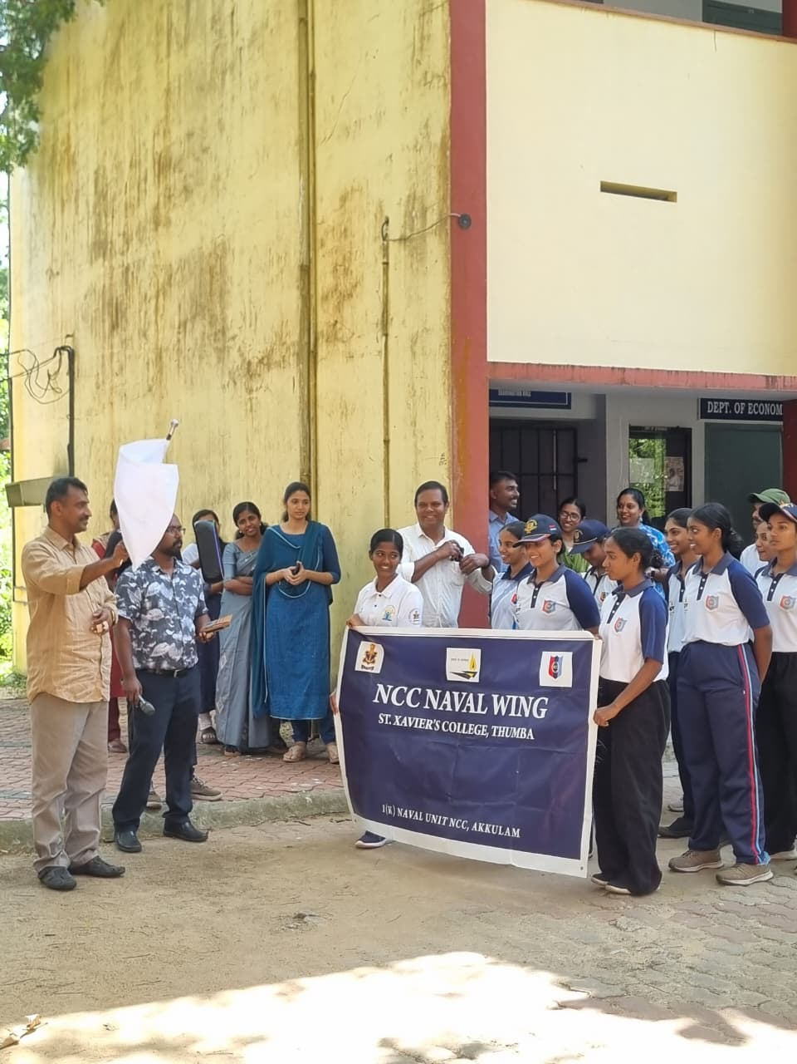
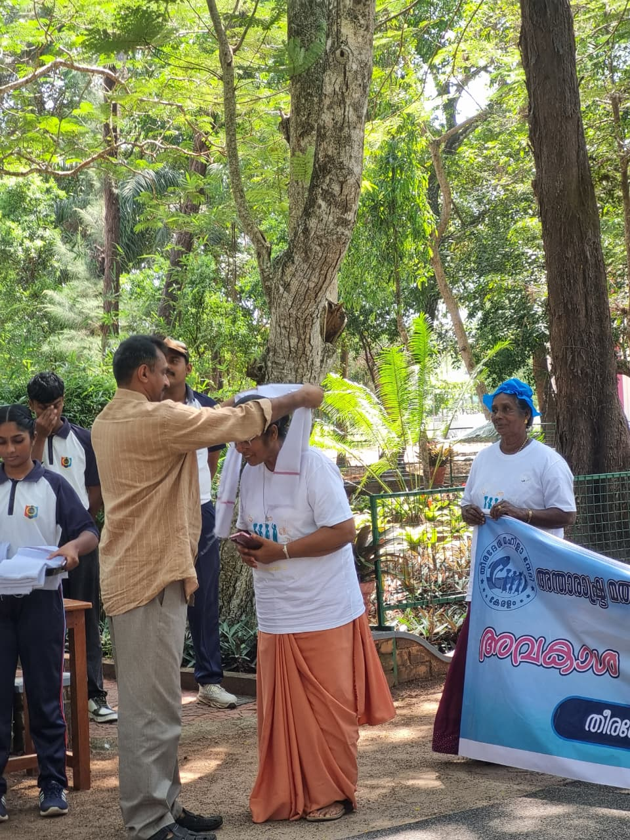
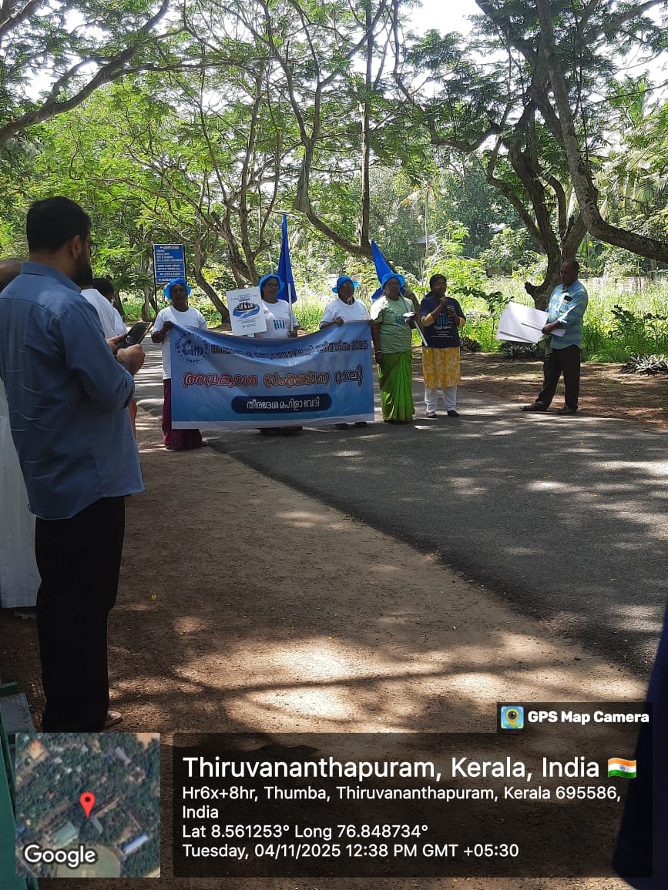
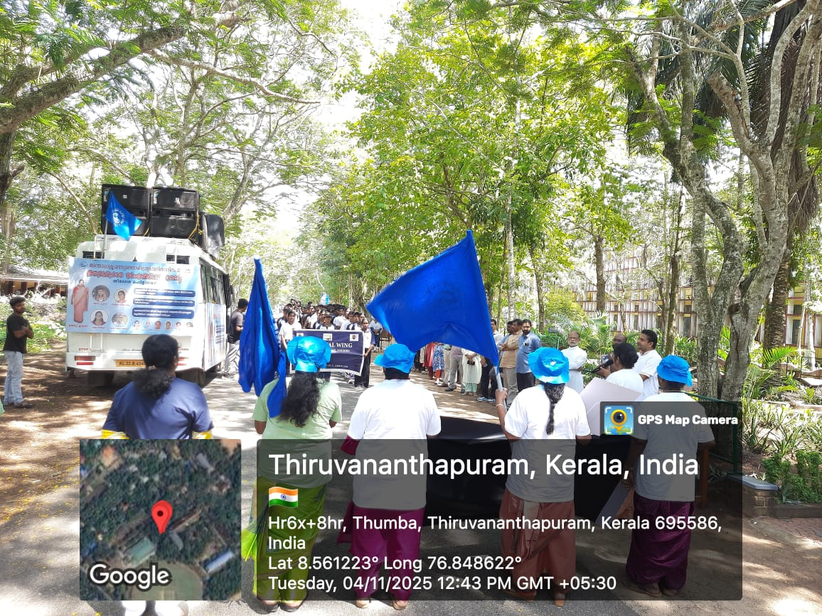
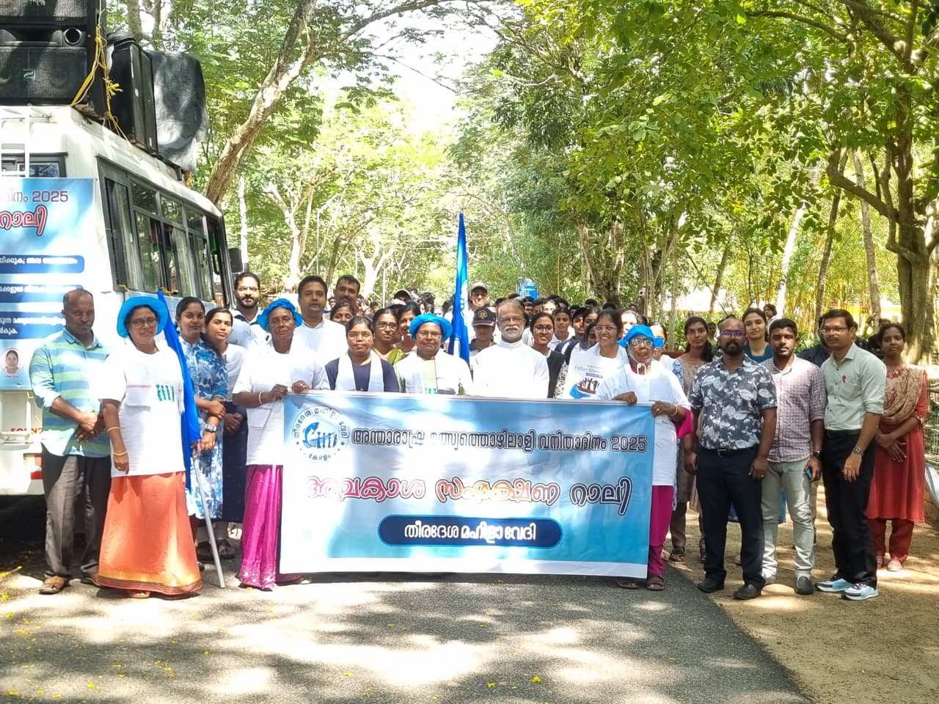

Slide 5

4) Extended whole-hearted support through sincere contributions to the “Happy Pages” - ‘ Gift a Story, Grow a Smile’ Initiative, organised by the College Union 2025-26, as part of the International Day of Happiness (20th March 2026).
The initiative aimed to set up a small library for the Children of Lenny Peters Girls’ Home, Vettuthura, encouraging the sharing of knowledge and joy, with the message – “One Book, One Child, One Smile”. Thus, the Human Rights Club Co-ordinators and Student Members also made honest contributions to it, and became a part of the extension activity for a noble cause, consciously driven by the idea that every child, irrespective of his/her socio-economic backgrounds, should be able to enjoy the right to live a happy, meaningful and dignified life, for which, education and reading are all inevitable.

Slide 6
THANK YOU

